Slide 1
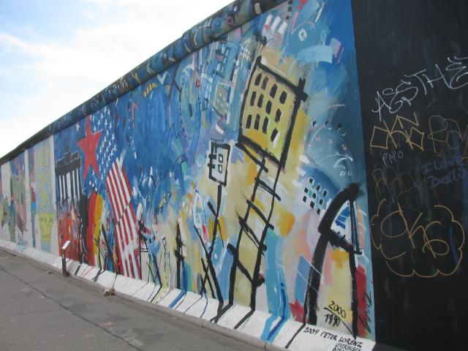

Slide 2
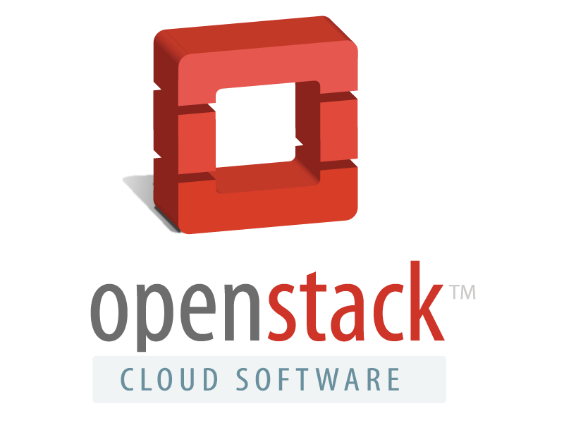

Slide 3
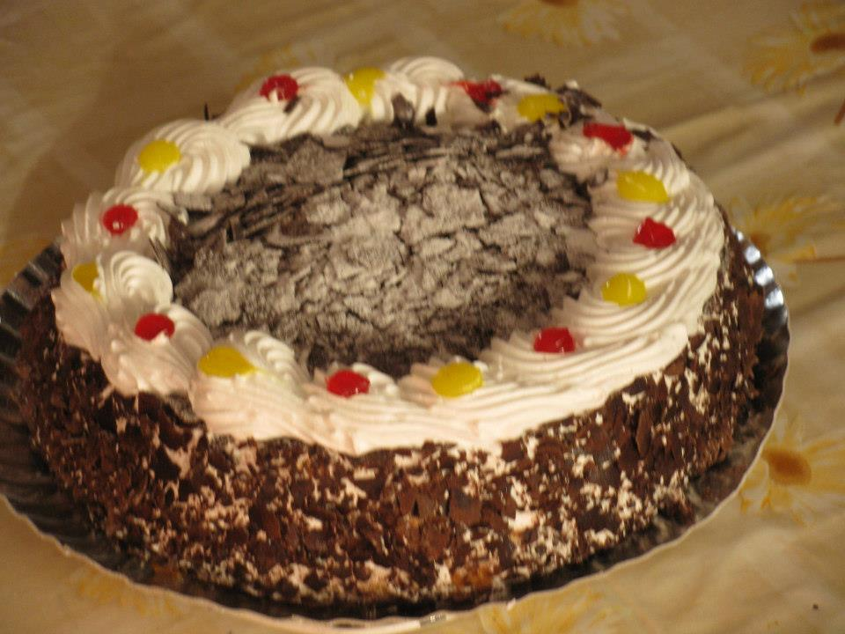
Agenda

Slide 4
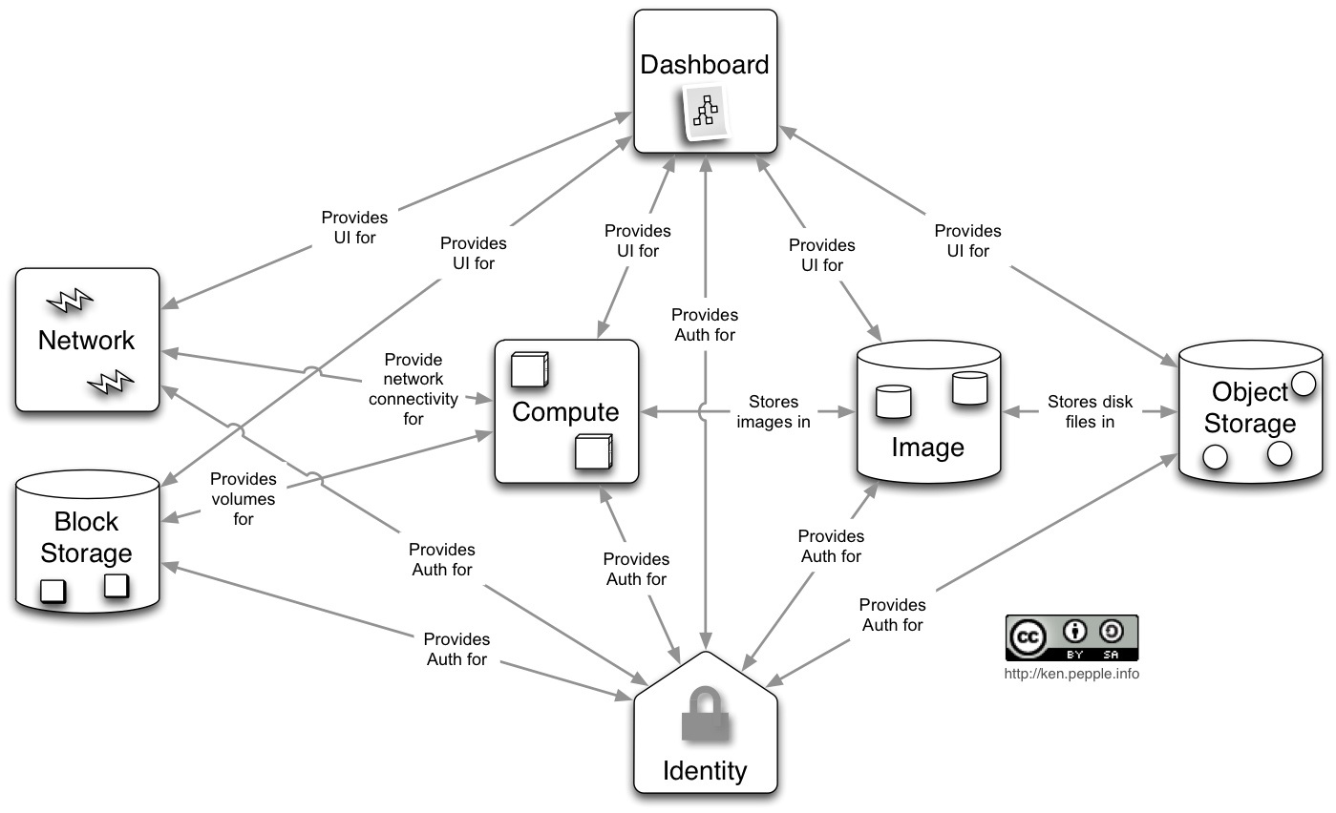

Slide 5


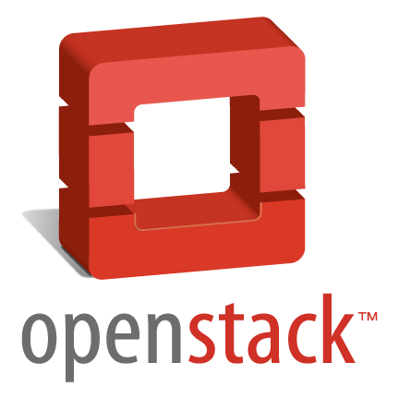

Slide 6
Over 100+ others

Slide 7
Also
VC have pumped in over > 100M USD
Startups & Eco System
Developed by more than 330 contributors who implemented 185 different features
In current stable release name “Folsom”

Slide 8
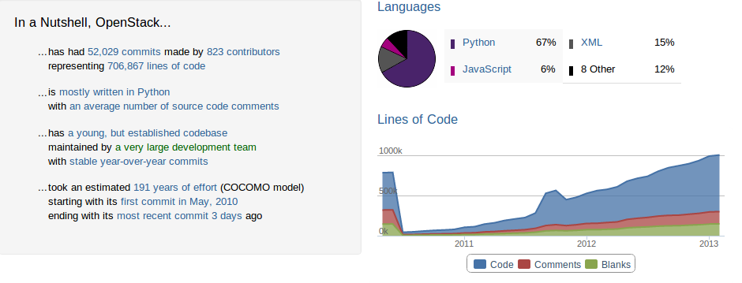

Slide 9
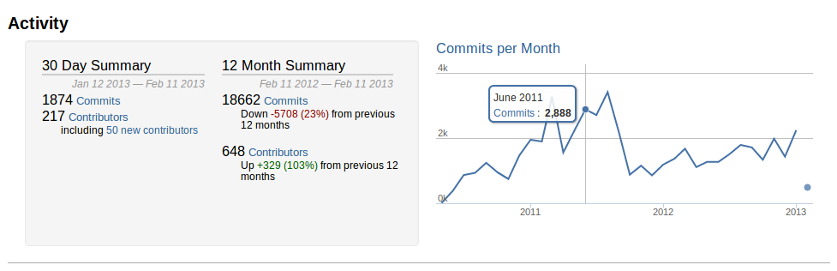

Slide 10
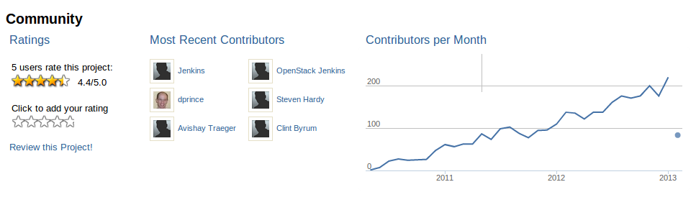

Slide 11
Release Cycle
June 2010 OpenStack Formed
Austin 21 October 2010
Bexar 3 February 2011
Cactus 15 April 2011
Diablo 22 September 2011
Essex 5 April 2012
Folsom 27 September 2012

Slide 12
Development cycle
6 months
Design, blueprint creation
Design Summit, 3 days to discuss and brainstorm
PTLs define cycle targets
Feature milestones every 4 weeks
Last feature milestone, no more features allowed
Release branch is cut, next cycle starts
Final release

Slide 13

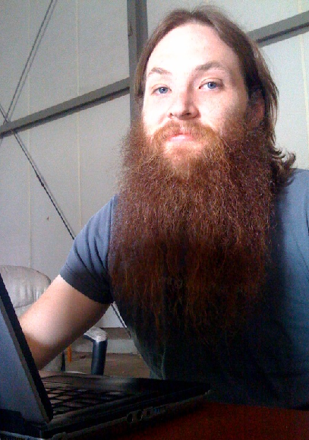


Journey of a feature
Design
Write
code
Code
review
Pre-merge
tests
Postmerge
tests
Milestone
Release
Final
Release
feature branch
trunk

Slide 14
OpenStack Foundation

Slide 15
Developers Sandbox Includes
Gerrit
Jenkins
Git
Launchpad
DevStack

Slide 16
And ..
Python love is highly required :)

Slide 17

OpenStack is... you, us
http://launchpad.net/openstack
  http://wiki.openstack.org
  http://planet.openstack.org
Twitter
@OpenStack
@OpenStackIndia

Slide 18
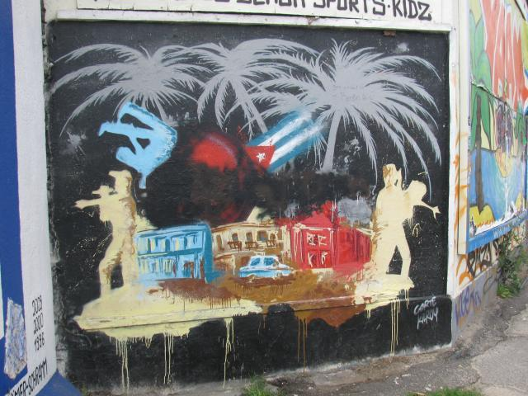
@koolhead17

